Slide 1
Predicting film-director ratings
Joshua Banks Mailman

Slide 2
Questions investigated
Characterizing response to film directors
The investor, sponsor, or granting agency that funds film directors may be interested in…
• Besides profit margins they may be interested in alternative gauges of success of a movie
• Crowd-sourced critical response to the films of prolific acclaimed directors are a valuable resource to exploit to address this.
Predicting the ratings of their films
Based on data freely available to the general public, it may be possible to a build predictive models tailored to various film directors of the past.
• Such types of models can also be applied to directors that are still active.
• Most of the film directors examined are still active today.
More info on how to use this template at www.slidescarnival.com/help-use-presentation-template
This template is free to use under Creative Commons Attribution license. You can keep the Credits slide or mention SlidesCarnival and other resources used in a slide footer.

Slide 3
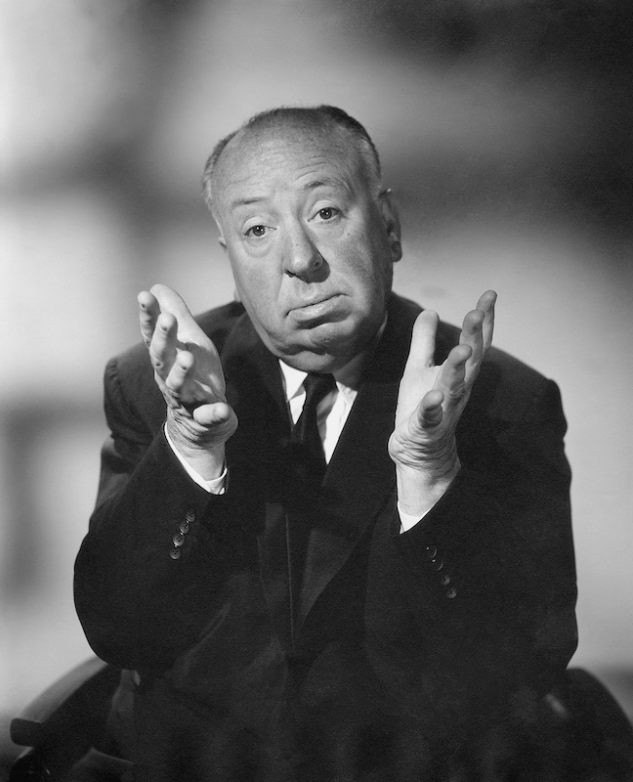
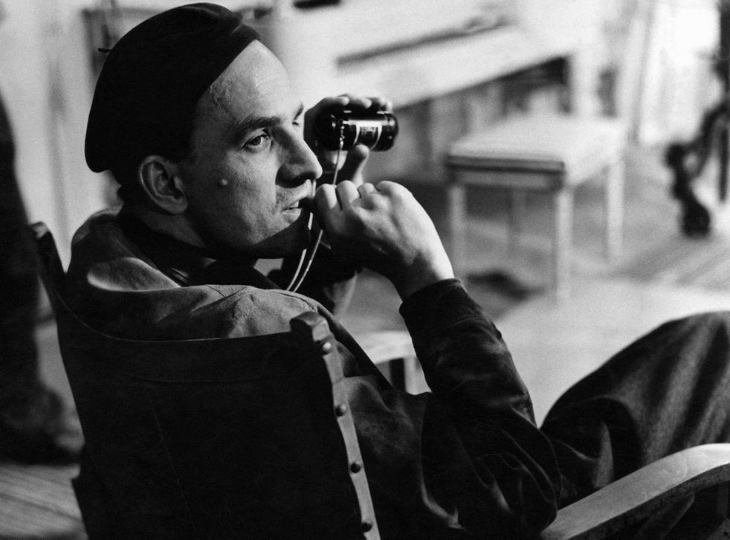
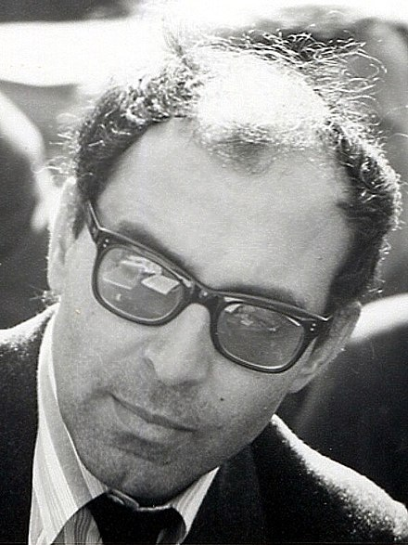
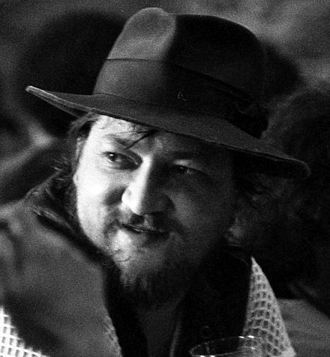
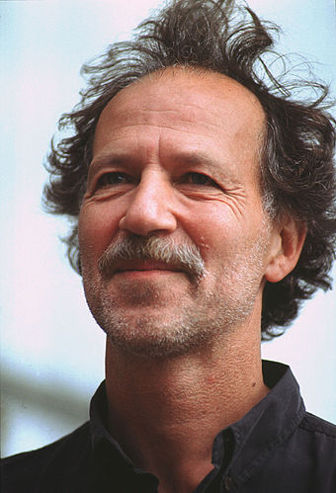
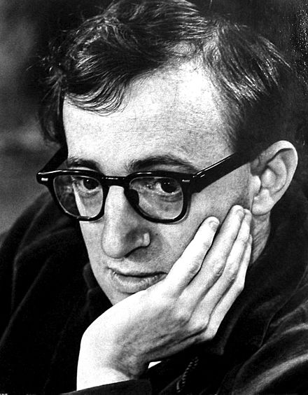
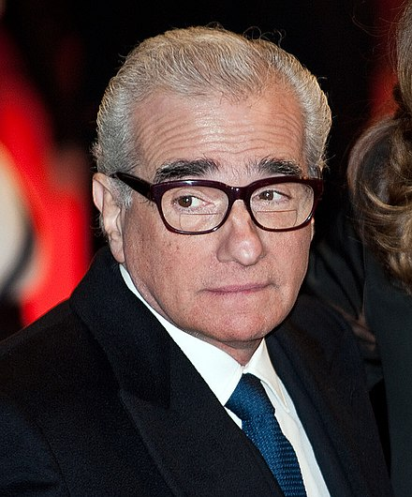
Who?
Seven acclaimed directors who are prolific
Alfred
Hitchcock
Ingmar Bergman
Jean-Luc Godard
Rainer Fassbinder
Werner Herzog
Woody Allen
Martin Scorsese

Slide 4
Source
IMDB (Internet Movie Database
• A nested web-scraping algorithm was required, since IMDB lists all of a director’s films on one page, but includes cast members and other info on a separate page dedicated to each film
• To improve on the worldwide gross box office returns data, www.the-numbers.com, was also scraped and joined, but this data was ultimately discarded for being incomplete

Slide 5
Target variable
Viewers’ Ratings
(scale from 1 to 10)

Slide 6
Target variable
Viewers’ Ratings
Features examined
continuous
Year released
Duration (in minutes)
Rating count (total number of times the film was rated on IMDB)
Budget
categorical
TV series vs. theatrical release
Documentary or not
Cinematographer
Cast members

Slide 7
9,000
Cleaned and Filtered
100%
7 directors x ~50 films each
x 15 actors & 10 other features
>
data points
As follows:
• Exclude actors appearing in < 3 films & one-off cinematographers
• Exclude films < 60 minutes
• Exclude films with crucial missing data and obvious outliers
• Exclude collinear features and those too often missing

Slide 8
Patterns in the data
Heatmap sorted by correlation to the target variable
rating count
rating count
rating count
year
budget
budget
year
duration
budget
Rating
Rating
Rating
Hitchcock
Allen
Herzog
Ingmar Bergman
Jean-Luc Godard
Rainer Fassbinder
Martin Scorsese

Slide 9
Patterns in the data
Alfred Hitchcock
Multicollinearity as expected between features and proxies for them, such as rating and metacritic score, and runtime and duration
Shapes of correlation
rating count
year
Rating
rating count
duration
budget
duration

Slide 10
To predict ratings:
Linear Regression
with train-test split to enable cross-validation
continuous features
Year released
Duration (in minutes)
Rating count (total number of times the film was rated on IMDB)
categorical features
TV series vs. theatrical release
Documentary or not
Cinematographer (excluding those who worked the least number of times with that director)
Cast members (if appearing in > 3 films)

Slide 11
Alfred Hitchcock and other directors, use a particular cinematographer during a particular phase of their career
Three of Hitchcock’s cinematographers
Jack E. Cox
(1920-30s)
Therefore cinematographer somewhat serves as a proxy for the time variable in years
Bernard Knowles
(late 1930s)
Robert Burks
(1950s-60s)

Slide 12
Linear regression models
 | A | B | C
Yellow | 10 | 20 | 7
Blue | 30 | 15 | 10
Orange | 5 | 24 | 16
R² values
on test-set after training
0.21
* Including two additional Allen films excluded for their genre and duration yielded slightly different results

Slide 13
Linear regression models
 | A | B | C
Yellow | 10 | 20 | 7
Blue | 30 | 15 | 10
Orange | 5 | 24 | 16
R² values
on test-set after training
* Including two additional Allen films excluded for their genre and duration yielded slightly different results

Slide 14
Linear regression models
 | A | B | C
Yellow | 10 | 20 | 7
Blue | 30 | 15 | 10
Orange | 5 | 24 | 16
R² values on test-set after training
fewer features
more
* Including two additional Allen films excluded for their genre and duration yielded slightly different results

Slide 15
How Hitchcock’s ratings rise
Smoothed moving average (lowess)
Hitchcock movies tend to be rated higher to the extent they are released later in his career and are rated by many
Feature
engineering
Regression on log of ratings count
Bring the attention of your audience over a key concept using icons or illustrations

Slide 16
Linear regression models
 | A | B | C
Yellow | 10 | 20 | 7
Blue | 30 | 15 | 10
Orange | 5 | 24 | 16
R² values on test-set after training
fewer features
more
* Including two additional Allen films excluded for their genre and duration yielded slightly different results

Slide 17
Linear regression models
R² values on test-set after training
Less stable
(higher variance, overfitting)
slightly more stable
(less variance, less overfitting)
fewer features
Allen
Hitchcock
more
year, duration, rating count, log(year), log(rating count)
Hitchcock
Important coefficients:
-50.668, -0.198, 0.101, 50.892, 0.560

Slide 18
Opposite trends
Hitchcock
Allen
R² on test set
R² on test set
0.37
0.78
0.36
0.68

Slide 19
Linear regression models
R² values shown in blue represent the best model for the given director, based on comparisons of mean absolute error (mae) between different sets of features and rows, and within the same set of features and rows, choosing Lasso vs. Ridge based on lower R²
A more thorough investigation using Lasso CV on all features
Polynomial Features
Contributors
(positive coefficients)
Gottfried John
El Hedi ben Salem
Walter Sedlmayr
Irm Hermann
Duration
Ulli Lommel
Margarethe von Trotta
Mia Farrow
Joe Pesci
tv series
Ewa Fröling
rating count
Carlo Di Palma (DOP)
Ringo Starr
duration
docu x Peter Zeitlinger (DOP)
Diane Keaton
rating cnt
log(rating cnt)
log(rating cnt)
Gordon Willis (DOP)
log(rating cnt)
tv series x Werner Herzog (appears)
log(rating cnt)
Michael Chapman (DOP)
log(rating cnt) x documentary
Greatest coefficients*:
Detractors
(negative coefficients)
Edward Chapman
Georg Funkquist
docu x Thomas Mauch (DOP)
year
Henry Northrup
Stig Olin
duration x tv series
Vilmos Zsigmond (DOP)
Darius Khondji (DOP)
* Font sizes are roughly proportional to absolute value of coefficients
DOP stands for director of photography, which is the cinematographer

Slide 20
Caveat:
 | A | B | C
Yellow | 10 | 20 | 7
Blue | 30 | 15 | 10
Orange | 5 | 24 | 16
Although average rating of a movie could vary up or down regardless of the rating count, the particular ratings can only exist in so far as there already exist ratings to count up. Therefore there is some question of:
Reflexivity
Therefore, can the ratings be predicted or interpreted without using rating count as a feature?

Slide 21
Linear regression models
without rating count as a feature
Polynomial Features
A more thorough investigation using Lasso CV on all features
Polynomial Features
Pairs of mean absolute errors (mae) are boxed if they are lower than the corresponding mae for a different sized set of features here (and slightly different sets of rows shown on the next slide).

Slide 22
Linear regression models
using budget as a feature
Polynomial Features
A more thorough investigation using Lasso CV on all features
Polynomial Features
Contributors
(positive coefficients)
Georges Staquet
budget x Raoul Coutard (DOP)
duration x J.P. Belmondo
Anna Karina x André S. Labarthe
Greatest coefficients*:
Detractors
(negative coefficients)
year
Pairs of mean absolute errors (mae) are boxed if they are lower than the corresponding mae for a different sized set of features here (and slightly different sets of rows shown on the previous slide).

Slide 23
Further investigations
Probe regularization with polynomial features to improve prediction
• Examine quantile-quantile plots
and individual interactions
Develop explanation
• Examine residuals in tandem with domain knowledge to discover and explain interactions between features, such as:
• budget & rating:
inversely correlated?
• duration ~ budget ?
• more visualizations

Slide 24
Further investigations
Alfred Hitchcock
Shapes of correlation
rating count
year
Rating
rating count
duration
and…
budget
duration

Slide 25
Hitchcock’s movies increased in duration
Their ratings have a sweet spot just past the middle
More visualizations for exploratory data analysis
rating

Slide 26
Further investigations
Probe regularization with polynomial features to improve prediction
• Examine quantile-quantile plots
and individual interactions
Develop explanation
• Examine residuals in tandem with domain knowledge to discover and explain interactions between features, such as:
• budget & rating:
inversely correlated?
• duration ~ budget ?
• more visualizations
and…

Slide 27
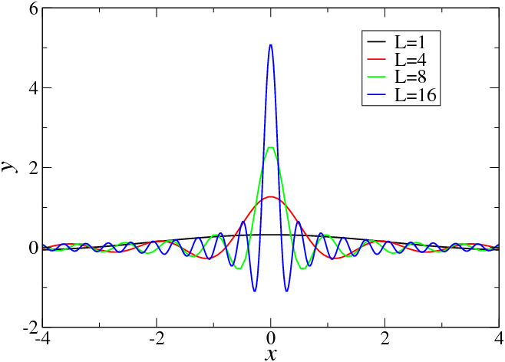
Feature engineering
100%
Model the spike in rating count, using the Dirac Delta function (”impulse” function)

Slide 28
Predicting film-director ratings
Joshua Banks Mailman
joshuabanksmailman@gmail.com
Thanks!

